Slide 1
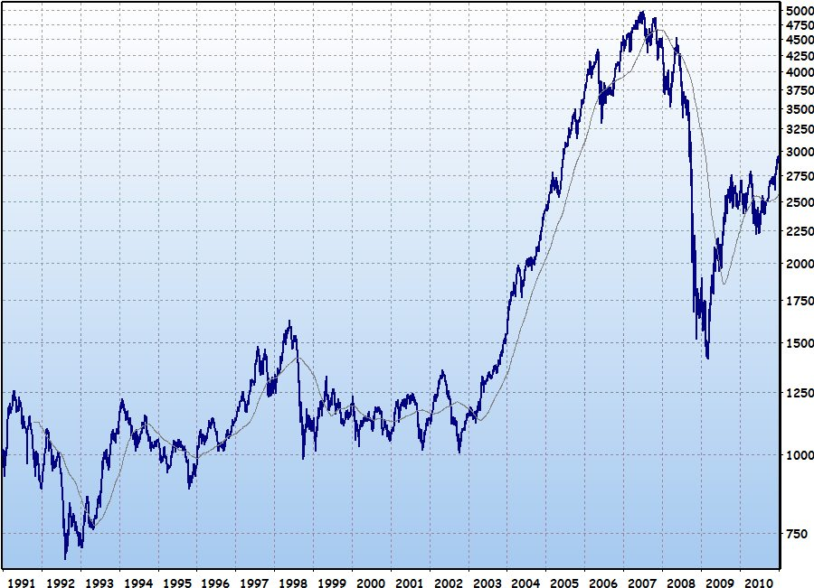
Stock Price Prediction
By:Talin Sai Upputuri

Slide 2
Introduction
Predicting the Stock price for a particular company is always interesting and intriguing
This kind of project can also be used as an academic interest, as we get to expose to different models and explore with neural networks
Overall, this project deals with the closing price share of the company’s stock using Linear Regression, Artificial Neural Networks(ANN) and Long Short-Term Memory(LSTM) and compare which of them performs better.

Slide 3
Data
The Data used is NY Stock Price Prediction which has the data from 2012-2016 the prices were fetched from different sources such as Yahoo Finance, and different sources from different financials databases
The data is extracted from Kaggle which has around 800k rows
The data used here is prices-split-adjusted.csv which have adjustments for the split.
The data has 6 columns date,open,close,low,high and volume

Slide 4
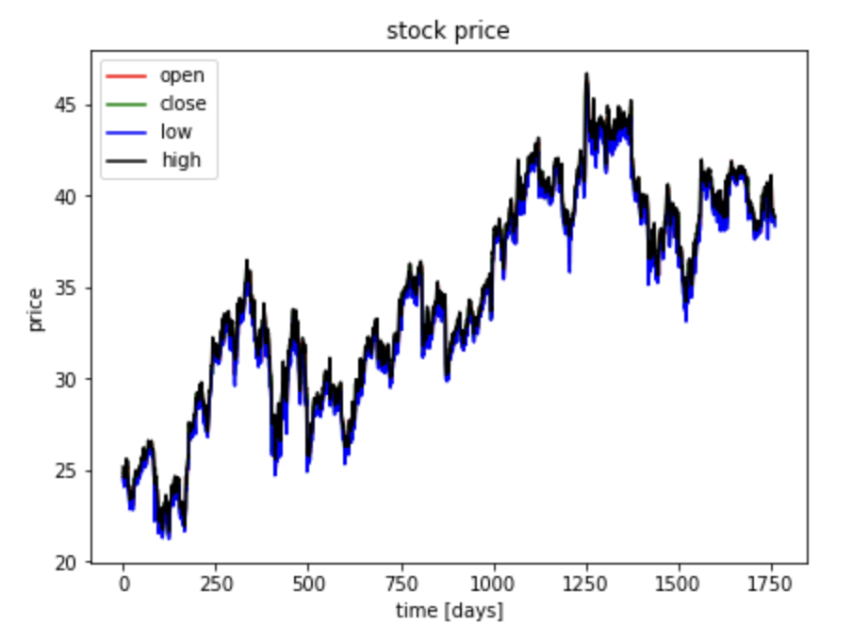
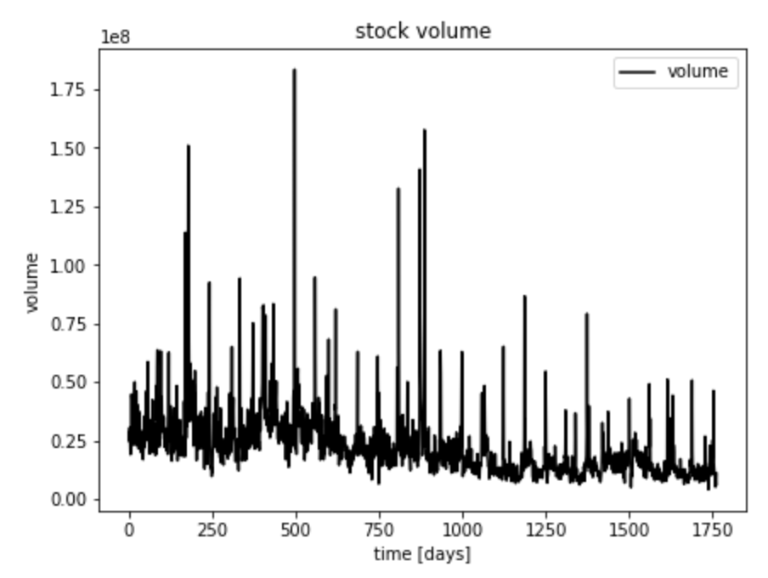
Visualization
Visualizing the Stock Price and volume for the company oracle(Symbol=ORCL)
To Check how the dat is performing overall as the date keeps on increasing

Slide 5
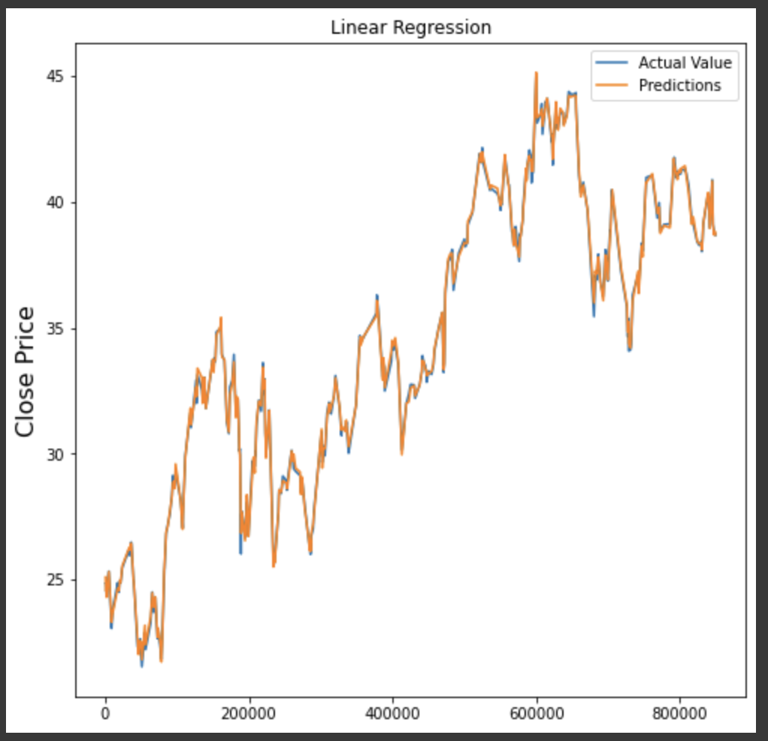
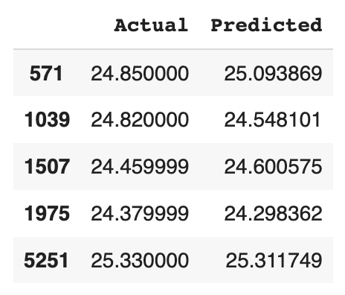
Model
Linear Regression:
Split the data using the train_test_split
Trained the Model with Linear Regression function
R2-Score is used as the metrics
Notes:
Dropped the columns which are volume and close and assigned the variable as X.
Close columns assigned as y

Slide 6
Artificial Neural Networks
ANN is a type of neural network which was inspired by the structure and function of the human brain.
It can be used for predicting as it has the ability to learn and adapt based on the data
Created a Sequential model of 4 dense layers with activation function as Rectified Linear Unit(Relu).
Notes:
ANN on historical stock price data, the model can learn to recognize patterns and trends in the data that may be indicative of future price movements.
ANNs may be useful for stock price prediction is that they can handle a large amount of input data and can learn to make predictions based on multiple input variables.

Slide 7
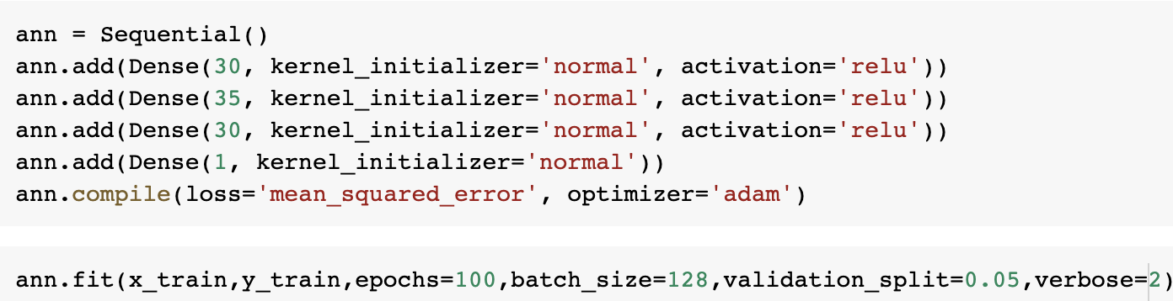
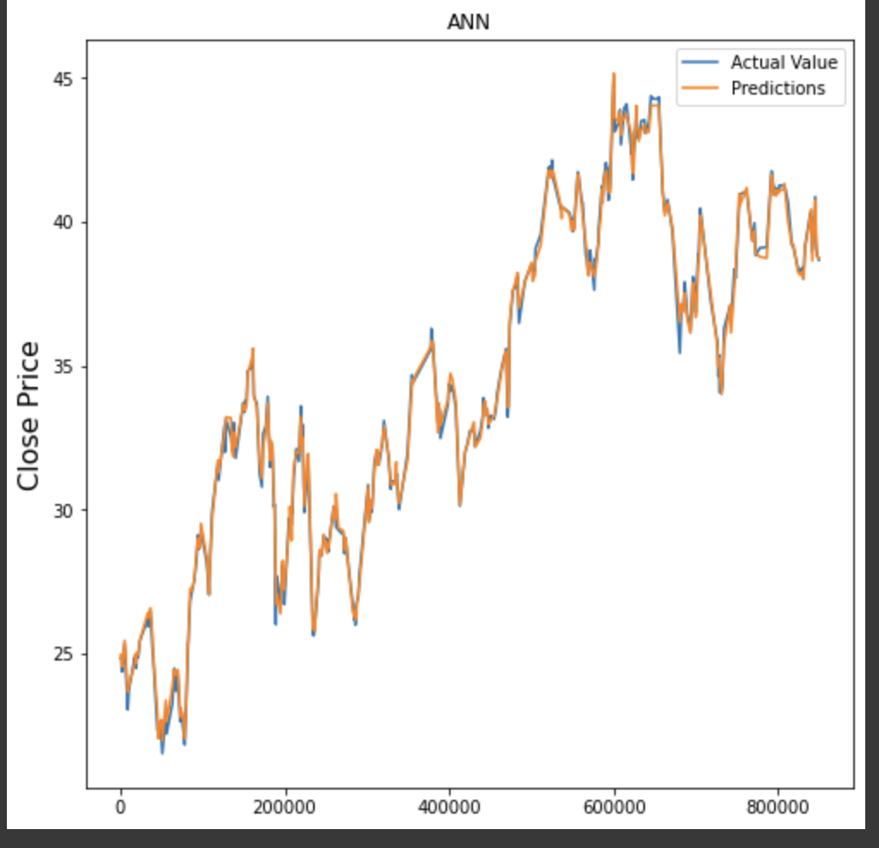
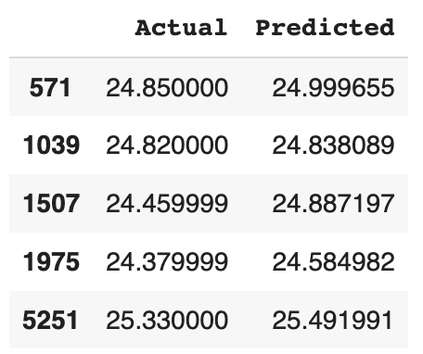
Results

Slide 8
Long Short Term Memory
LSTM is type of recurrent neural network which is widely and well suited for modeling time series data.
Designed to process sequential data that makes particularly useful for predicting
These are particularly useful for tasks that involve long short term dependencies as past outcomes can impact future outcomes.

Slide 9
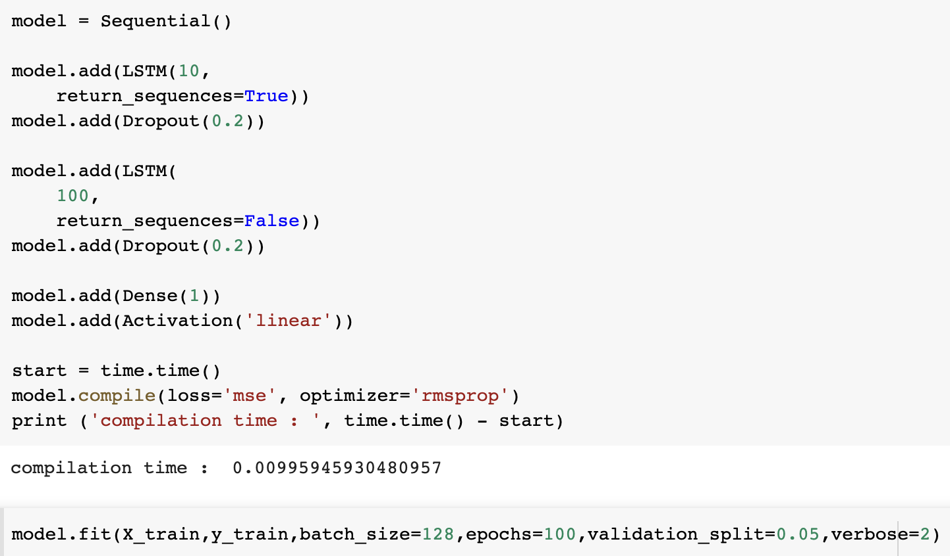
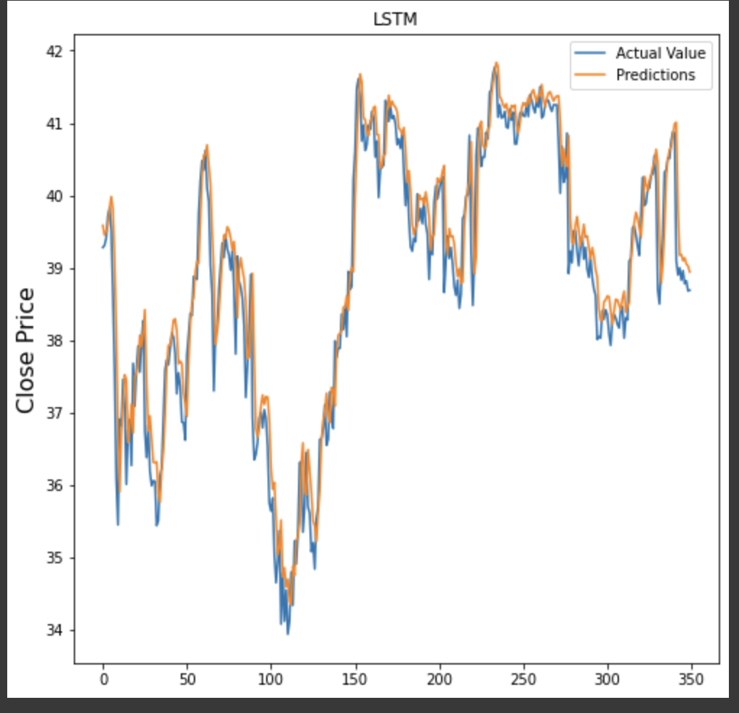
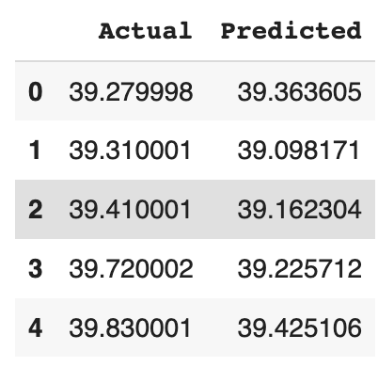
Results

Slide 10
Conclusions
Linear Regression and ANN are simpler models than LSTM and also generally faster to train and easier to implement
Performed better than LSTM is that there is a clear linear relationship between the input variables and the target variable
In contrast, LSTM is more designed for complex data and high variance data.

Slide 11
Challenges
Macro economic factors
Micro economic factors
Company Culture
Present Trend
Environment

